Slide 1
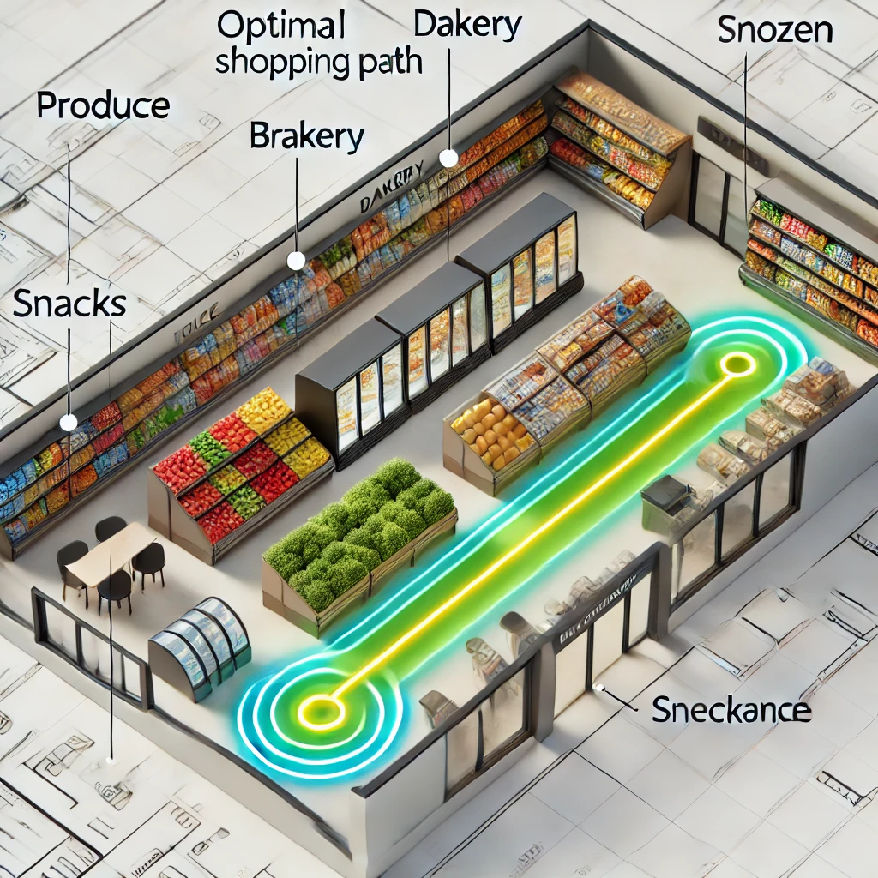
Route Planning in Supermarkets
NAME:
Tushar Tyagi (1BM22CS311)
T. Likitha (1BM22CS312)
Yashraj Sinha (1BM22CS335)
Prateek Jana (1BM22CS356)
Presented to:
Prameetha Pai
Assistant Professor

Slide 2



Problem Statement
CHALLENGES FACED BY SHOPPERS
Customers often find supermarkets overwhelming due to layout complexity, leading to inefficient shopping experiences and longer times spent in stores.
Scenario: A customer visits a supermarket in a hurry with a list of items to buy.
Goal: Optimize the shopping route to minimize the total time spent.
Constraints:
Navigate through predefined sections of the supermarket.
Start at the entrance and finish at the checkout.
Pick items only from specified sections.

Slide 3
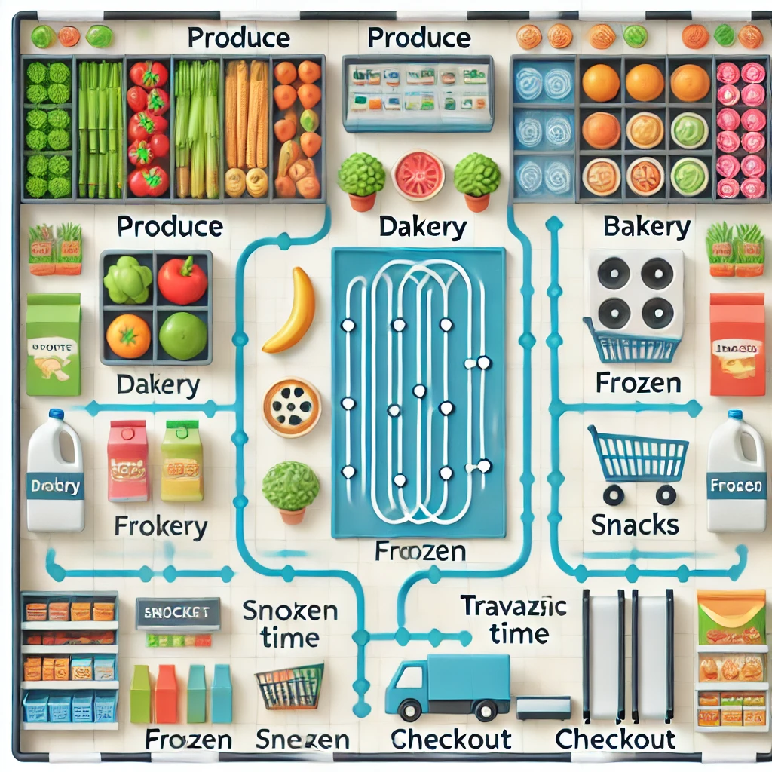
Understanding Store Layout, Making a List
Store Layout:
Sections: Entrance, Produce, Dairy, Bakery, Frozen, Snacks, Checkout.
Connected paths between sections with specified traversal times.
Making a List:
User inputs a list of items.
Each item is mapped to a store section.
Only valid sections corresponding to the items are considered for the route.

Slide 4
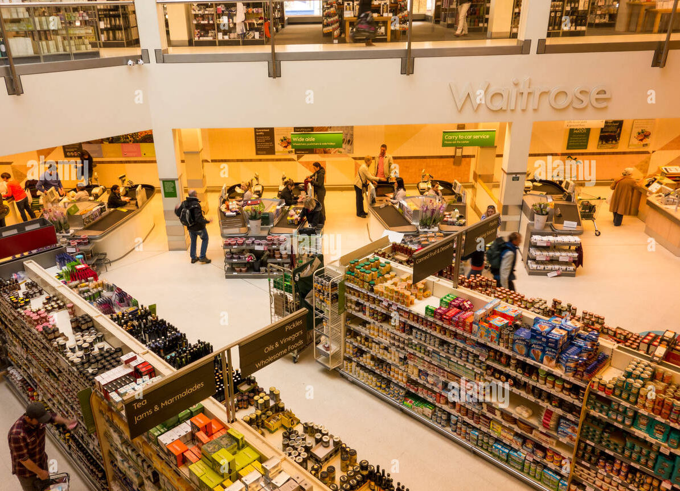
Planning the Route
MAP OUT ESSENTIAL SECTIONS
Identify key areas such as produce, dairy, and dry goods. Plan to hit these sections in a logical order.
Input:
List of sections derived from user input.
Store graph with traversal times.
Approach:
Generate all permutations of user sections.
Add "Entrance" at the start and "Checkout" at the end of each permutation.
Calculate total traversal time for each route.
Choose the route with the minimum time.

Slide 5

Time Management Tips
Prioritize items in a logical order to minimize movement.
Pre-plan the shopping route using a clear map.
Use efficient algorithms to calculate the shortest path.
Avoid backtracking or visiting unnecessary sections.

Slide 6
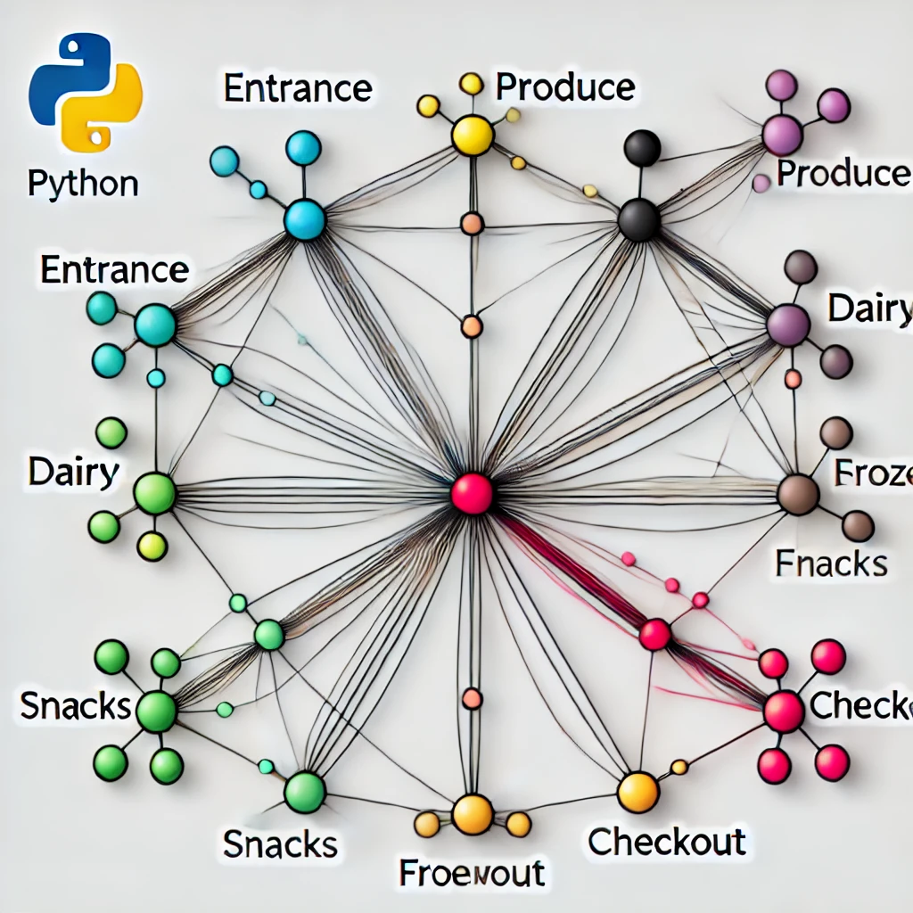
Approach Used
Data Representation:
Modeled the store as a graph using NetworkX.
Nodes: Store sections.
Edges: Paths with traversal times as weights.
Algorithm:
Used permutations to evaluate all possible routes.
Calculated shortest path between nodes using shortest_path_length().
Chose the optimal path with the least time.
Visualization:
Displayed the store layout and the optimal path using Matplotlib.

Slide 7

Time Complexity Achieved
Computation:
Generating permutations of n user sections: O(n!)O(n!)O(n!).
Calculating shortest path for each permutation: O(V+E)O(V + E)O(V+E) per pair of nodes.
Overall Complexity:
Approximately O(n!⋅(V+E))O(n! \cdot (V + E))O(n!⋅(V+E)), where nnn is the number of user-selected sections, VVV is the number of nodes, and EEE is the number of edges.
Optimization:
Works well for small values of nnn.
For larger inputs, heuristic approaches like Ant Colony Optimization (ACO) or Dijkstra’s algorithm could be explored.

Slide 8

Thank
You !!

